Slide 1

DATA
RETRIEVAL

Slide 2
Contents
SELECT Statement
Column Alias
Concatenation Operator
Arithmetic Expressions with SELECT
Rules of Precedence of Arithmetic Operators
WHERE Clause
Operators used in WHERE
ORDER BY Clause

Slide 3
SELECT Statement
SQL statement used for retrieval of data is the SELECT statement.
Syntax:
SELECT [DISTINCT|ALL] {*| column1 [alias], column2 [alias]…….}
FROM tablename;
SELECT lists one or more columns
DISTINCT Eliminates the display of duplicate tuples
* Selects all columns
column selected column names
alias gives selected columns different headings
FROM To specify the table or tables from where columns are selected

Slide 4
Understanding SELECT Statement
This statement must have two clauses
SELECT clause: specifies the columns that you want to display.
FROM clause: specifies the tables that contain those columns.
Here, the words SELECT and FROM are called keywords.
Optional keyword DISTINCT is used only when you need to eliminate the display of duplicate rows.

Slide 5
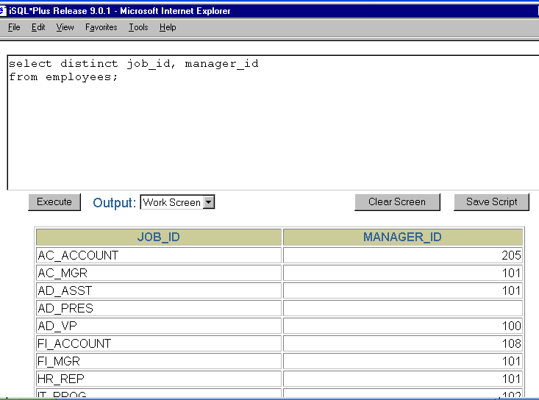
Example

Slide 6
Selecting all columns
Displaying all columns of data in a table, we place an asterisk(*) after the SELECT keyword.
The asterisk represents all columns in a table.
Result - when we execute the statement, all columns from the table are displayed.

Slide 7
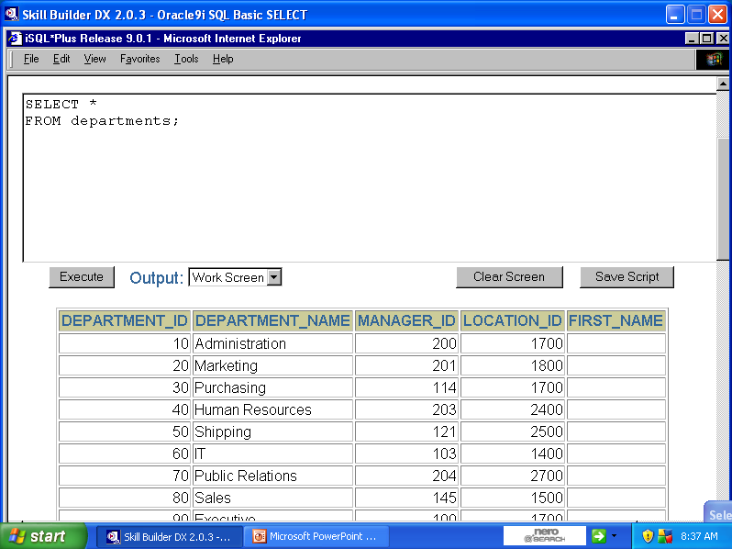
Using asterisk(*)

Slide 8
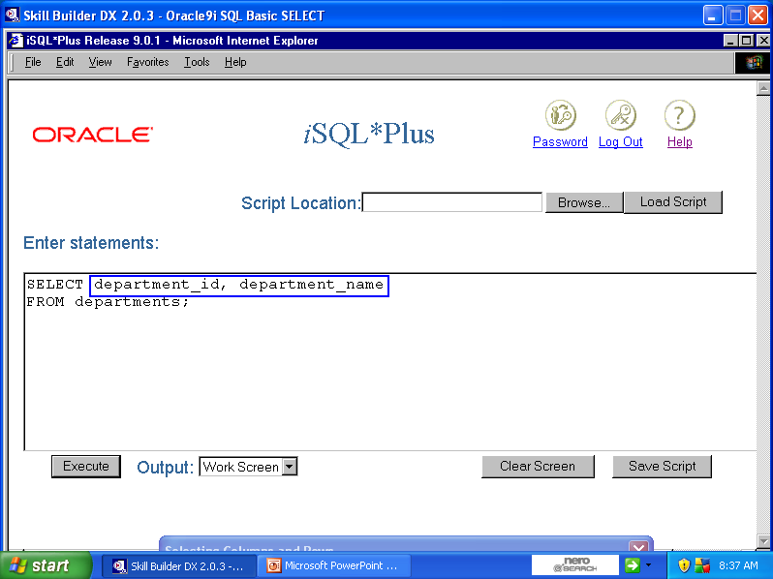
Selecting required columns
You can restrict the number of columns being displayed by listing only the required columns in the SELECT clause as shown above, each column should be separated by a comma(,) but not given after the last column

Slide 9
Using column alias in SELECT
You can use a column alias to assign a different name to a column heading.
By using an alias, you can display a more descriptive heading for a column. It is also useful with calculations.
The alias is specified in the SELECT clause after the appropriate column name or expression separated by the AS keyword or by a space
Example:
SELECT SName As Name
FROM students;
OR
SELECT SName Name
FROM students;

Slide 10
Concatenation Operator ||
The concatenation operator can be used to concatenate or link columns to other columns, arithmetic operators, or constant values.
When you link a column to one of these elements, the output displays a single column that is a character expression
The concatenation operator is represented by two vertical bars (||)
Columns on either side of the operator are combined to display a single column.

Slide 11
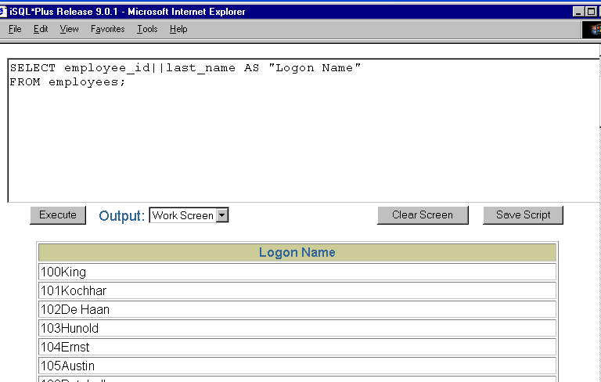

Slide 12
Literal Character String
A literal is a character, a number, or a date
Date and character literal values must be enclosed within single quotation marks (‘ ‘) but number literals need not.
This can be included in the SELECT clause
Each character string is output once for each row returned.

Slide 13
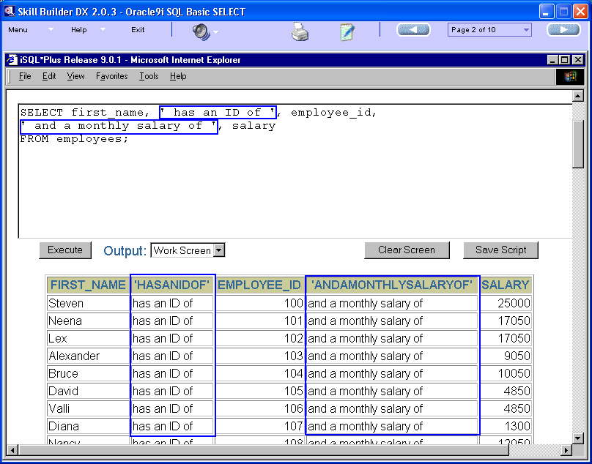
Literal Character String

Slide 14
Arithmetic Expressions in SELECT
An arithmetic expression may contain
column names,
constant numeric values, and
the arithmetic operators:
available operators in SQL are: addition(+), subtraction(-), multiplication(*), and division(/)
You can use arithmetic operators in any clause of a SQL statement except the FROM clause.
These expressions can be used if we need to modify the way in which data is displayed, perform calculations, or look at what-if scenarios.

Slide 15
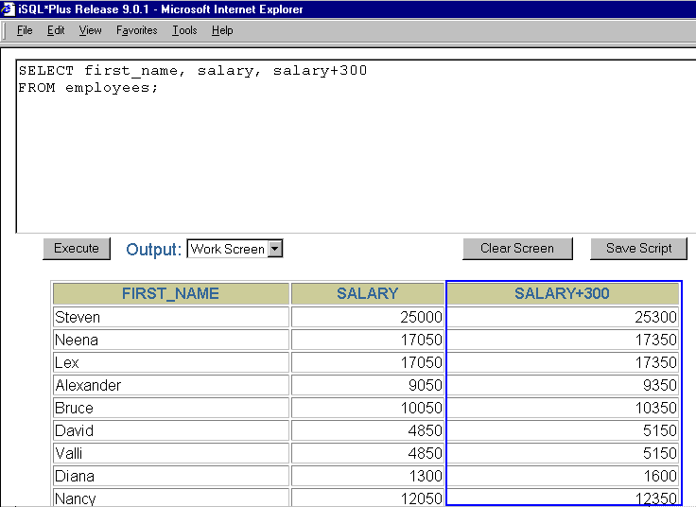
Example

Slide 16
Arithmetic Expressions with NULL
When you perform arithmetic operations on NULL values, the result is always NULL.
An empty field is said to contain NULL.
A NULL value is not the same as zero or space.
A NULL value is defined as a value that is either Unavailable or Unassigned or Unknown or Inapplicable.
NULL * 30 = NULL 0 * 30 = 0
NULL / 10 = NULL 0 / 10 = 0
100 + NULL = NULL 100 + 0 = 100
100 – NULL = NULL 100 – 0 = 100

Slide 17
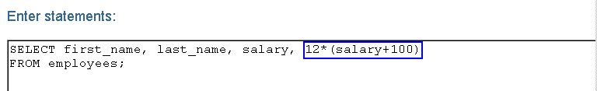
Rules of Precedenec
HIGHEST
LOWEST
Multiplication and division take priority over addition and subtraction.
Operators of the same priority are evaluated from left to right.
Parentheses are used to force prioritized evaluation and to clarify statements.

Slide 18
The WHERE Clause
Syntax:
SELECT [DISTINCT ] {* | column [alias],…….}
FROM table
[WHERE <condition(s)> ; ]
WHERE Clause consists of one or more conditions
[] it is an optional clause

Slide 19
The WHERE Clause
By inserting a WHERE clause into a SQL statement, you can specify a condition that must be met, and only the rows that meet the condition are returned.
This is also known as selection property of SQL Statement.
The WHERE clause directly follows the FROM clause in the SQL statement syntax.
The WHERE clause consists of the WHERE keyword and a condition or conditions.

Slide 20
Condition of the WHERE Clause
SELECT [DISTINCT] | * column [alias],……
FROM table;
WHERE column_name operator column_name/constant/value
The condition in a WHERE clause specifies a comparison of values that limits the rows returned by a query.
The condition consists of three elements.
First is a column name,
Second is a comparison operator and
Third element can be another column name, constant, or list of values.

Slide 21
Guidelines to specify values
For text/date values in SQL
they must be specified within single quotes (most database systems will also accept double quotes).
For numeric values in SQL
they should not be enclosed in quotes.
For example:
WHERE column_name=‘Tiger’
WHERE column_name=’24-FEB-12’
WHERE column_name=13897.9

Slide 22
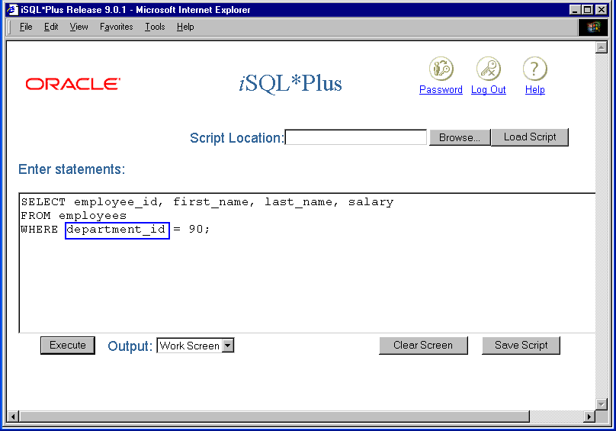
Example

Slide 23
Operators used in WHERE
Operator | Description
= | Equal
<> | Not equal
> | Greater than
< | Less than
>= | Greater than or equal
<= | Less than or equal
BETWEEN…AND | Between an inclusive range
LIKE | Search for a pattern
IN | If you know the exact value you want to return for at least one of the columns
IS NULL | Is a null value
Note** - In some versions of SQL the <> operator may be written as !=

Slide 24
Example of Comparison Operator
1. SELECT *
FROM Persons
WHERE P_Id < 3;
2. SELECT *
FROM Persons
WHERE P_Id BETWEEN 1 AND 3;
3. SELECT *
FROM Persons
WHERE P_Id <> 3;
4. SELECT *
FROM Persons
WHERE P_Id IN (1, 3);
Valid Values: P_Id = 1 or 2
Valid Values: P_Id = 1 or 2 or 3
Valid Values: P_Id = any value other than 3
Valid Values: P_Id = 1 or 3

Slide 25
Between Operator
SELECT column_name1, column_name2
FROM table
WHERE column_name1 BETWEEN lower_limit AND upper_limit;
The result will all rows where
column_name1 value >= lower_limit and <= upper_limit
Here, datatype of lower limit and upper limit can be any literal value

Slide 26
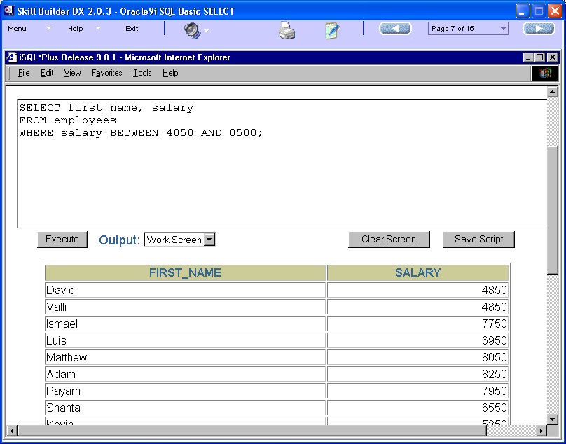
Example of BETWEEN

Slide 27
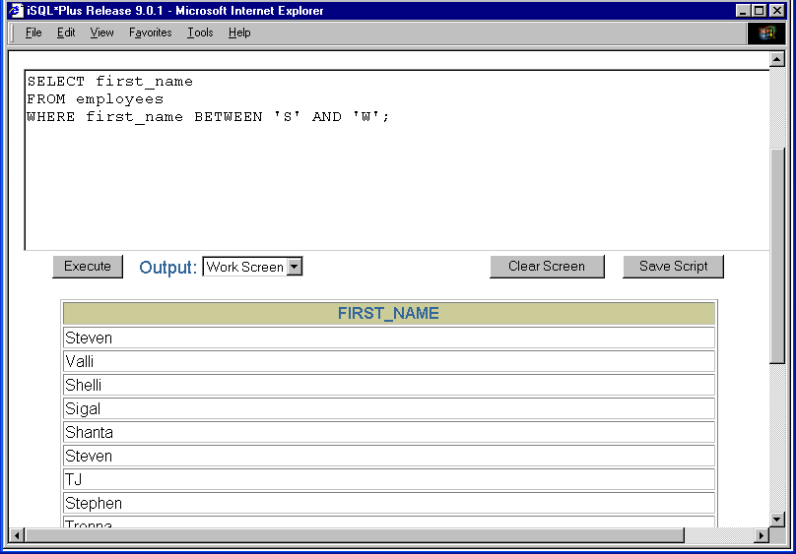
Example with String Literal

Slide 28
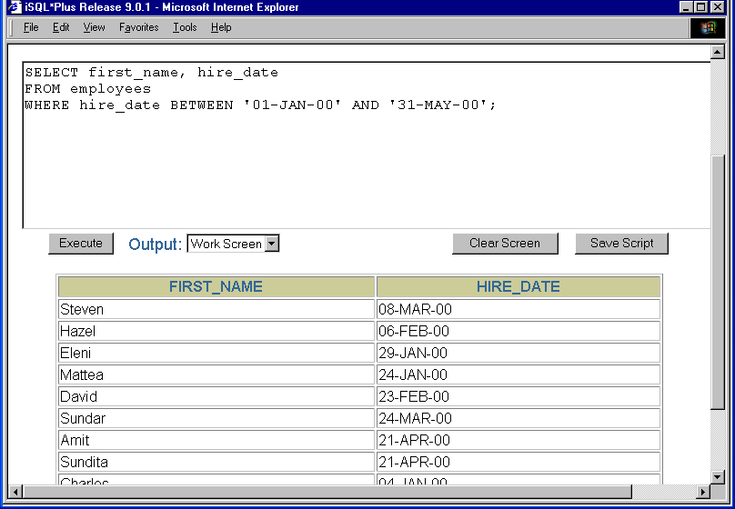
Example with Date Literal

Slide 29
IN Operator
SELECT column_name1, column_name2
FROM table
WHERE column_name1 IN (value1,value2,…,valueN)
The IN operator can be used if we know the exact value we want to return for at least one of the columns
Example
WHERE column_name1 IN (1024,4055,8099)
WHERE column_name1 IN (‘INDIA’,’FRANCE’)
WHERE column_name1 IN (’12-JAN-12’,’31-DEC-11’)

Slide 30
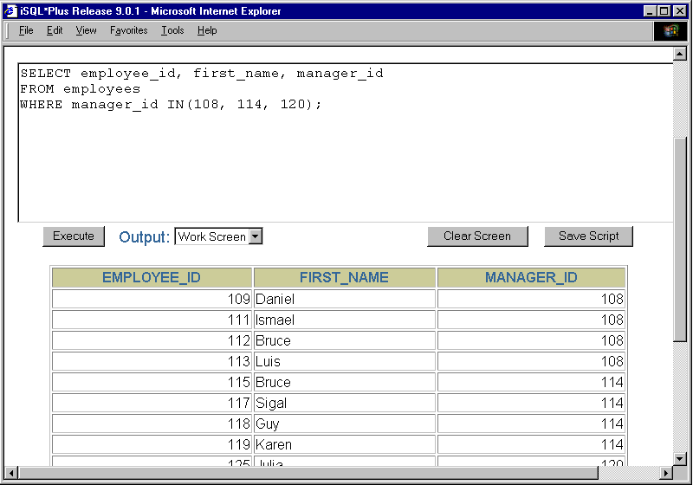
Example: IN

Slide 31
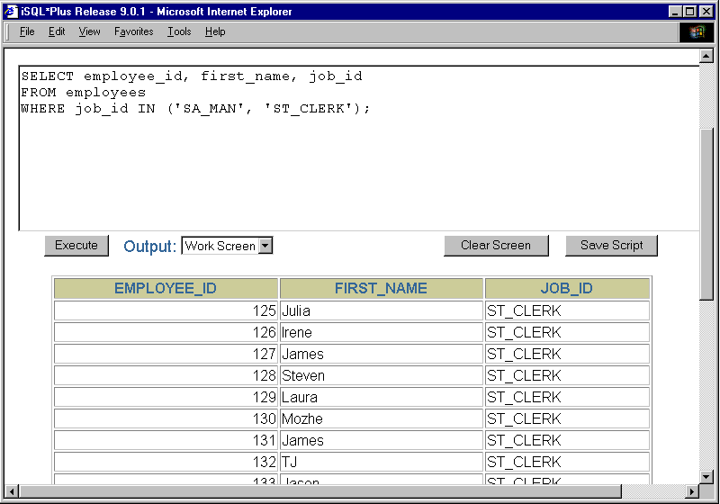
Example: IN

Slide 32
LIKE Operator
By using the LIKE condition, we can select rows that match a character pattern
The character-pattern matching operation is referred to as a wildcard search.
Two symbols can be used to construct the search string, as given below:
The pattern checking is case-sensitive
Symbol | Description
% | Represents any sequence of zero or more characters
_ | Represents any single character

Slide 33
LIKE Operator: Syntax
SELECT column_name1, column_name2
FROM table
WHERE column_name1 LIKE ‘value including wildcard’;
1. SELECT *
FROM Persons
WHERE firstname LIKE ‘S%’;
2. SELECT *
FROM Persons
WHERE firstname LIKE ‘%s%’;
3. SELECT *
FROM Persons
WHERE firstname LIKE ‘S _ _’;
4. SELECT *
FROM Persons
WHERE firstname LIKE ‘S_m%’;
Retrieves rows whose names starts with capital S only followed by any no. of letters
Retrieves rows whose names contain a small letter s
Retrieves rows whose names starts with capital S only followed by 3 letters
Retrieves rows whose names starts with capital S only followed by any 1 letter and ending in letter m

Slide 34
IS NULL Operator: Syntax
The NULL conditions include
IS NULL condition and
IS NOT NULL condition.
SELECT column_name
FROM table
WHERE column_name IS NULL;

Slide 35
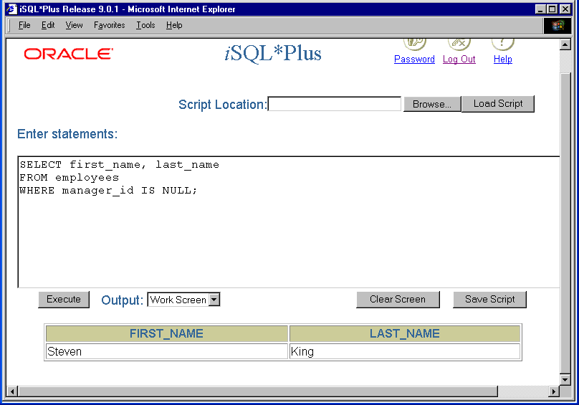
Example: IS NULL

Slide 36
Logical Operators
A logical condition combines the result of two component conditions to produce a single result based on them or inverts the result of a single condition.
Logical Operator | Meaning
AND | Returns TRUE if both component conditions are true
OR | Returns TRUE if either component condition is true
NOT | Returns TRUE if the following condition is false

Slide 37
AND Operator: Syntax
SELECT column_name1, column_name2
FROM tablename
WHERE condition1
AND condition2;
The rows returned are those which satisfy both the conditions
Example
SELECT *
FROM Persons
WHERE firstname LIKE ‘S%’
AND dob IN 2010;

Slide 38
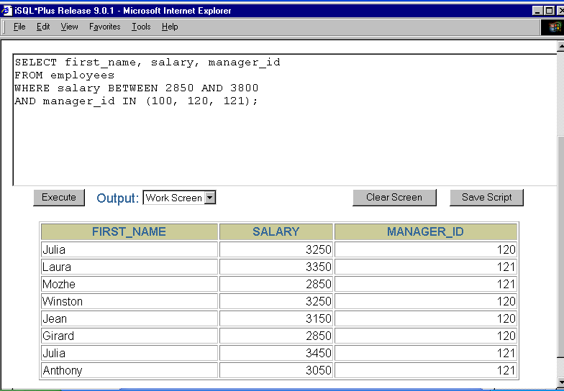
Example: AND

Slide 39
OR Operator: Syntax
SELECT column_name1, column_name2
FROM tablename
WHERE condition1
OR condition2;
The rows returned are those which satisfy either of the conditions
Example
SELECT *
FROM Persons
WHERE firstname LIKE ‘S%’
OR firstname LIKE ‘A%’

Slide 40
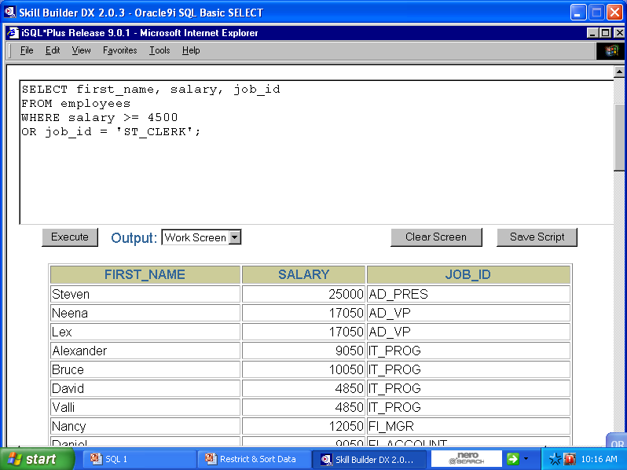
Example: OR

Slide 41
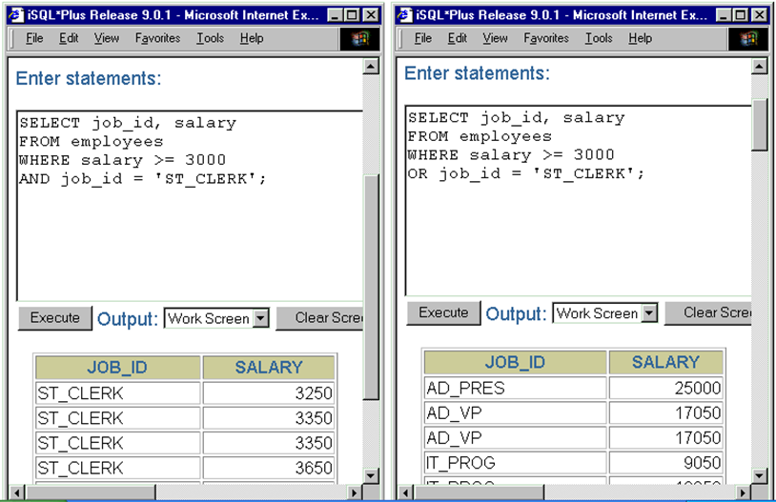
AND & OR: Comparison

Slide 42
NOT Operator: Syntax
SELECT column_name1, column_name2
FROM tablename
WHERE column_ name1 NOT operator value;
PLACEMENT OF NOT IN WHERE CLAUSE
NOT IN
NOT BETWEEN
NOT LIKE
IS NOT NULL
The rows returned are those which satisfy the condition

Slide 43
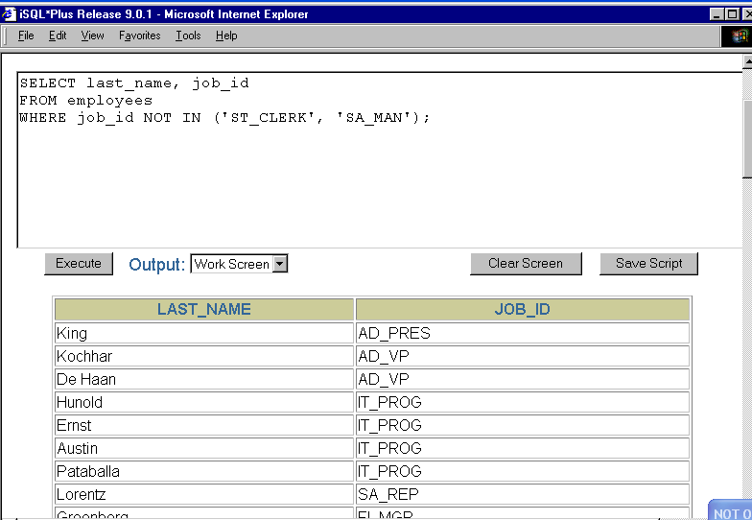

Slide 44
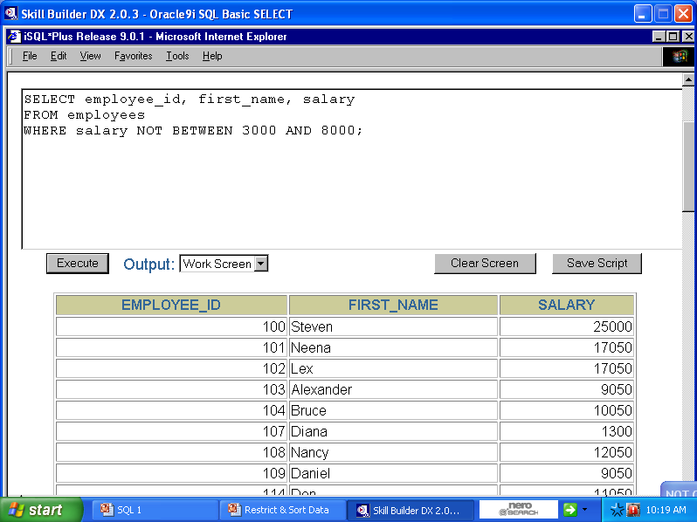

Slide 45
Rules of Precedence
These rules determine the order in which expressions are evaluated and calculated.
You can override the default order by using parentheses around the expressions you want to calculate first.
Order Evaluated | Operator
1 | Arithmetic Operators
2 | Concatenation Operator
3 | Comparison Conditions
4 | IS [NOT] NULL, LIKE, [NOT] IN
5 | [NOT] BETWEEN
6 | NOT logical condition
7 | AND logical condition
8 | OR logical condition

Slide 46
Example: Precedence
SELECT *
FROM Persons
WHERE P_ID > 10
AND firstname LIKE ‘M%’
OR firstname LIKE ‘N%’;
Order of evaluation:
First find people having id > 10 → P
Then out of P, find the ones whose name starts with M or N

Slide 47
Example: Precedence
SELECT *
FROM Persons
WHERE P_ID > 10
AND (firstname LIKE ‘M%’ OR firstname LIKE ‘N%’)
Order of evaluation:
First find people whose name starts with M or N → X
Then out of X, find people having ID > 10

Slide 48
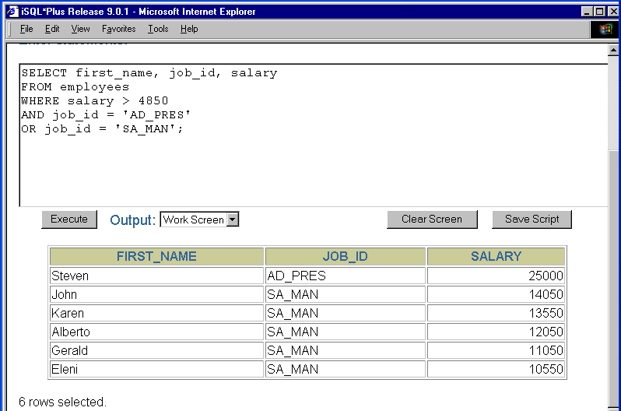

Slide 49
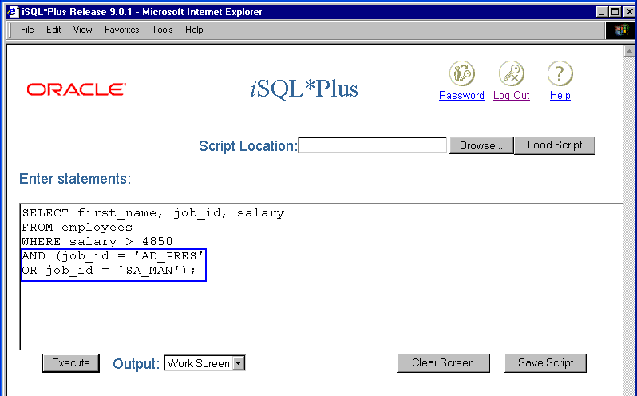

Slide 50
ORDER BY Clause: Syntax
SELECT [DISTINCT] | * column [alias],……
FROM table;
[WHERE <condition(s)>]
[ORDER BY column [ASC|DESC];]
Its an optional clause
The ORDER BY Clause is used for arranging the selected rows and then they are displayed .
The arrangement does not affect how rows are stored only how they are viewed
Whenever we use this clause, it must be the last clause of the SELECT statement

Slide 51
ORDER BY Clause
By default, this clause when used will arrange the rows in ascending order of the reference column
We can choose to display in the descending order by specifying the keyword DESC after the reference column
Example:
SELECT *
FROM Persons
ORDER BY dob;
SELECT *
FROM Persons
ORDER BY dob DESC;

Slide 52
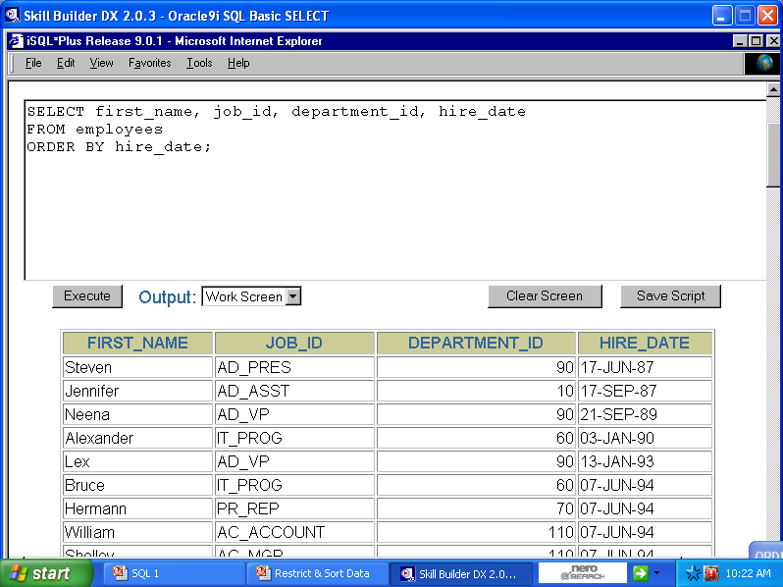

Slide 53
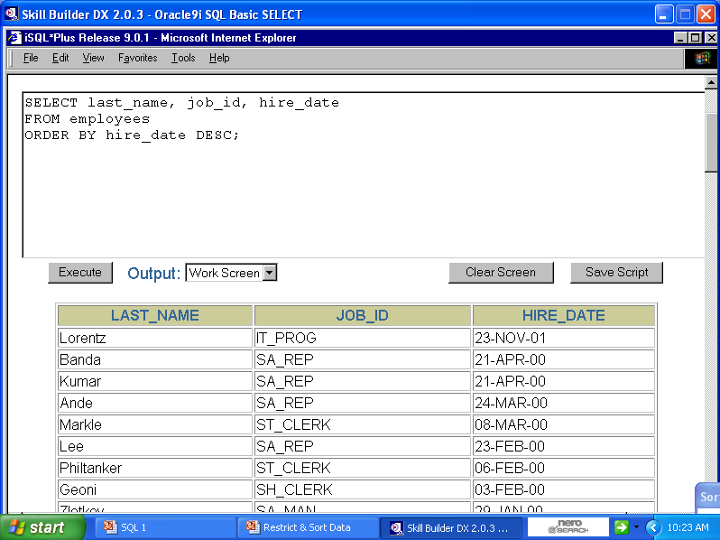

Slide 54
ORDER BY Clause: Multiple Columns
SELECT [DISTINCT] {* |column [alias],……}
FROM tablename;
[WHERE <condition(s)>]
[ORDER BY column1,column2;]
Here, the ordering will done based on n-columns as the reference column
The arrangement will be based on the order of how the reference columns are specified in the ORDER BY clause
From the syntax, arrangement will in done in ASC order first by column1 then by column2

Slide 55
Try this exercise
PERSON
DOB | FIRSTNAME
1-JAN-1999 | Amar
23-OCT-2010 | Peter
31-MAR-2000 | Anne
1-JAN-1999 | Tyllilang
23-OCT-2010 | David
SQL> SELECT dob,firstname
FROM person
ORDER BY dob,firstname;
Result next slide

Slide 56
Exercise: Result
RESULT
DOB | FIRSTNAME
1-JAN-1999 | Amar
1-JAN-1999 | Tyllilang
31-MAR-2000 | Anne
23-OCT-2010 | David
23-OCT-2010 | Peter

Slide 57
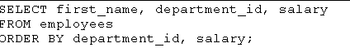
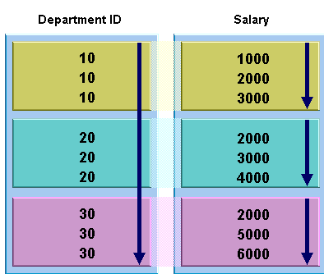
Sorting by multiple columns

Slide 58
Oracle Commands
SELECT table_name FROM user_tables;

Slide 59


